Slide 1

Hate speech classification
Adrianna Klimczak, Adam Kowalczyk and Marcel Wenka

Slide 2
Goal of this project
Machine learning model for automatic cyberbullying detection and hate speech classification for polish language
Tweets collected from openly available Twitter discussions and forums
Three possible classes of tweets:
0 (non-harmful)
1 (cyberbullying)
2 (hate-speech)

Slide 3
Exploratory Data Analysis
Class | Count
0 | 9190
1 | 253
2 | 598
Notes:
Additionally, we performed analysis on the word counts, word lengths and text length per class. Due to time restrictions, we will not show them during presentation, but feel free to look them up in our report.

Slide 4
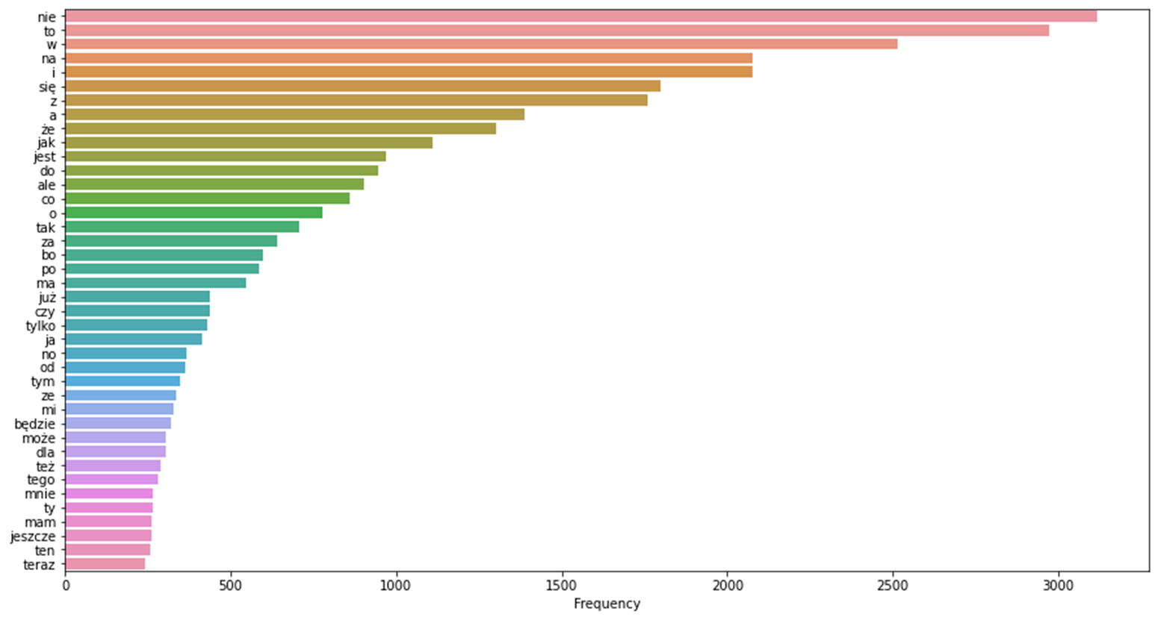
Stop words

Slide 5
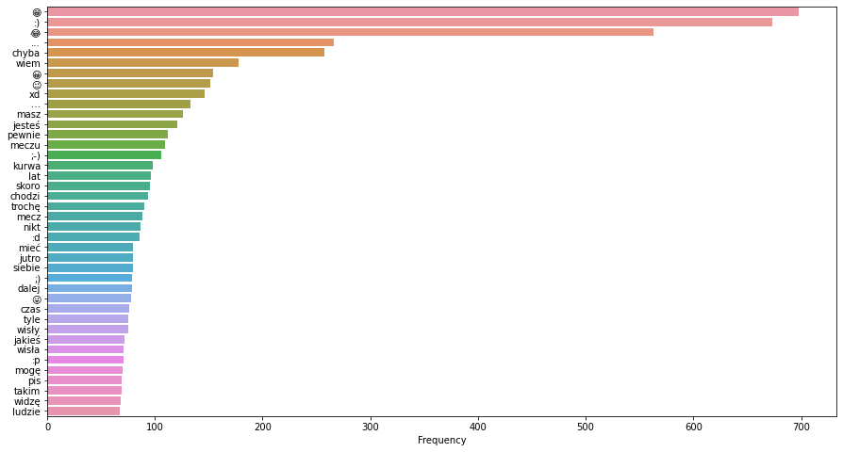
Non-stop words

Slide 6
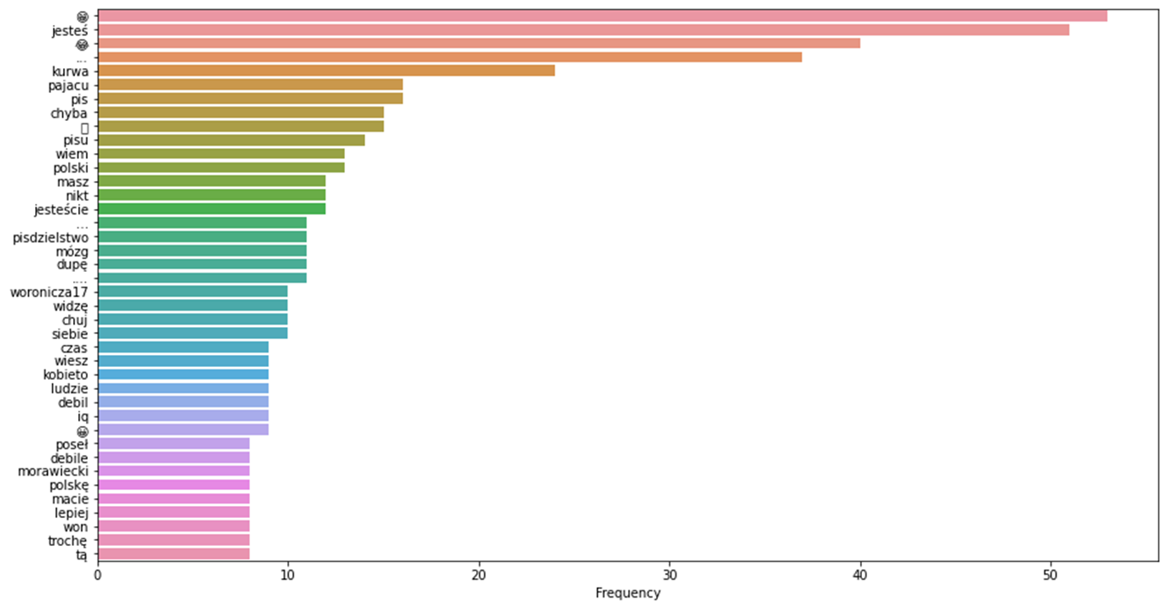
Non-stop words in harmful tweets

Slide 7
Preprocessing
Stripping leading and trailing whitespaces
[TFIDF] Replacing all whitespaces with spaces
Removing retweet tags (“RT”)
Removing leading and trailing responses and mentions
[RoBERTa] Removing emojis
[TFIDF] Removing punctuation
[TFIDF] Removing stop words

Slide 8
RoBERTa
Sławomir Dadas, 2019, “A repository of Polish NLP resources” https://github.com/sdadas/polish-nlp-resources/
Embedding taken from the second last layer:
Mean
CLS token
http://jalammar.github.io/illustrated-bert/
Notes:
We also tested different BERT models. We started with BERT and performed a few experiments with HerBERT, which is the highest ranked polish BERT model according to KLEJ ranking (benchmark for best contextual NLP models, English GLUE ranking counterpart).

Slide 9
RoBERTa (base)
 | SVM Linear | SVM RBF | Random Forest | Scikit MLP | Custom MLP
F1 micro | 0.861 | 0.812 | 0.867 | 0.885 | 0.839
F1 macro | 0.520 | 0.522 | 0.316 | 0.479 | 0.531
Embedding time: 10-15 minutes
Model size: 0.623 gigabytes

Slide 10
RoBERTa (large)
 | SVM Linear | SVM RBF | Random Forest | Scikit MLP | Custom MLP
F1 micro | 0.875 | 0.844 | 0.866 | 0.890 | 0.852
F1 macro | 0.525 | 0.571 | 0.309 | 0.508 | 0.544
Embedding time: 25-30 minutes
Model size: 2.11 gigabytes

Slide 11
RoBERTa: base vs large
 | base |  | large
 | Scikit MLP | Custom MLP | SVM RBF | Scikit MLP
F1 micro | 0.885 | 0.839 | 0.844 | 0.890
F1 macro | 0.479 | 0.531 | 0.571 | 0.508
Embedding time | 10-15 minutes |  | 25-30 minutes
Model size | 0.623 gigabytes |  | 2.11 gigabytes

Slide 12
RoBERTa + TFIDF
 | SVM Linear |  | SVM RBF |  | Custom MLP
 | F1 micro | F1 macro | F1 micro | F1 macro | F1 micro | F1 macro
TFIDF | 0.861 | 0.520 | 0.812 | 0.522 | 0.839 | 0.531
RoBERTa | 0.875 | 0.525 | 0.844 | 0.571 | 0.852 | 0.544
Combined | 0.896 | 0.560 | 0.848 | 0.570 | 0.866 | 0.567

Slide 13
Application demo

Slide 14
Chosen bibliography
PolEval 2019. Task 6: Automatic cyberbullying detection, 2019.
F. E. Ayo et al. “Machine learning techniques for hate speech classification of twitter data: State-of-the-art, future challenges and research directions”
K. Florio et al. “Time of your hate: The challenge of time in hate speech detection on social media” Applied Sciences, 10(12), 2020
S. Malmasi and M. Zampieri “Challenges in discriminating profanity from hate speech”, 2018
E. Ptaszynski and F. Masui “Automatic cyberbullying detection: Emerging research and opportunities”, 2018

Slide 15
Questions?

